Slide 1
CODE : A.T.M PRESENTED BY : MUHAMMAD WALEED. STUDENT ID : 16799.

Slide 2
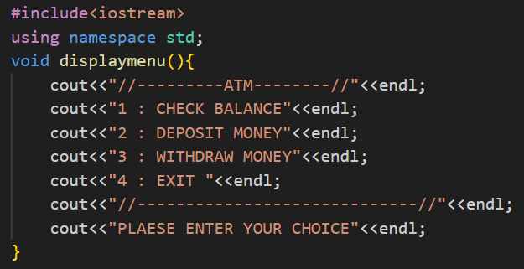
void displaymenu(): A function that shows an ATM
menu.
void: Means the function doesn’t
return a value.
cout: Displays text on the screen.
endl: Moves to the next line.

Slide 3
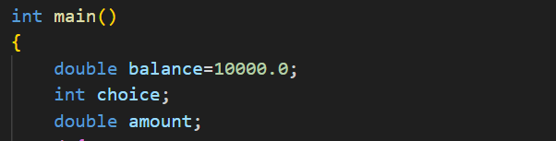
int main(): Entry point of the program.
double balance = 10000.0;: Stores the initial balance (10,000.0).
int choice;: Holds the user’s menu choice.
double amount;: Stores the deposit or withdrawal amount.

Slide 4
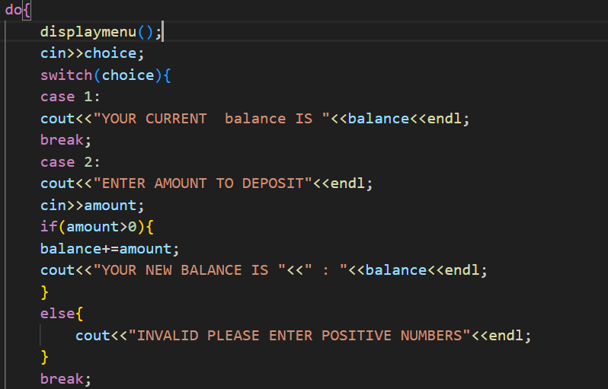
do {}: Runs the menu repeatedly.
displaymenu();: Shows the ATM menu.
cin >> choice;: Takes the user’s input.
switch(choice): Executes based on input:
Case 1: Show current balance.
Case 2: Deposit amount:
If valid, update balance.
Else, show error.

Slide 5
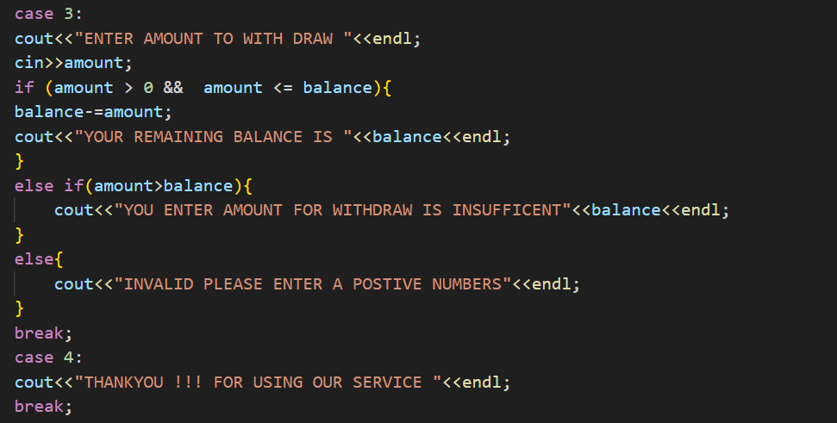
Case 3: Withdrawal Operation
1. Prompt User
Displays: "Enter amount to withdraw."
2. Input Handling
Takes withdrawal amount from the user.
3. Conditions:
Valid Amount
If amount > 0 && amount <= balance:
Deduct amount from balance.
Display: "Your remaining balance is <balance>."
Insufficient Balance
If amount > balance:
Display: "Amount entered is insufficient."
Invalid Input
If amount <= 0:
Display: "Invalid, please enter a positive number."

Slide 6
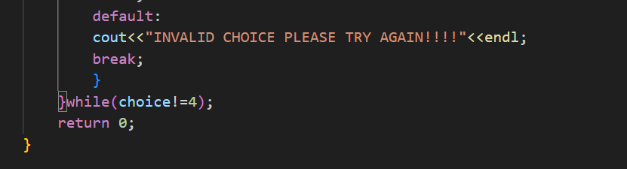
Default Case:
Invalid Choice
Displays: "INVALID CHOICE, PLEASE TRY AGAIN!!!"
Executes the break; statement to exit the current iteration.
Loop Control (Do-While Loop)
1. Purpose: Repeats the menu until the user enters 4.
2. Condition: while(choice != 4);
Exits the loop if choice==4
Program Termination
After the loop ends, the program exits with:
return 0;

Slide 7
“”THANKYOU “”

